Slide 1
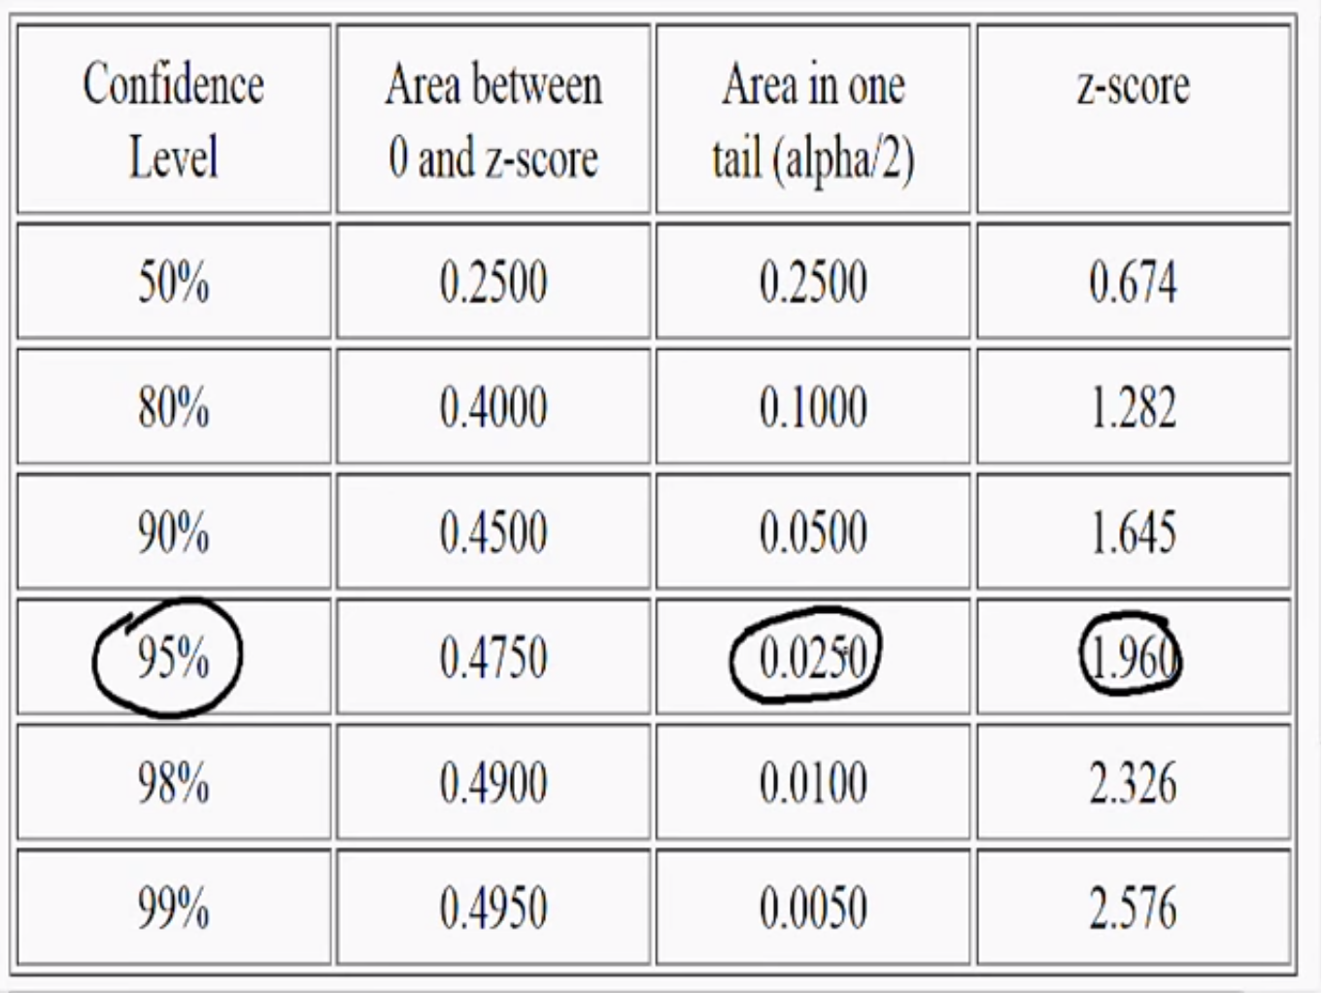

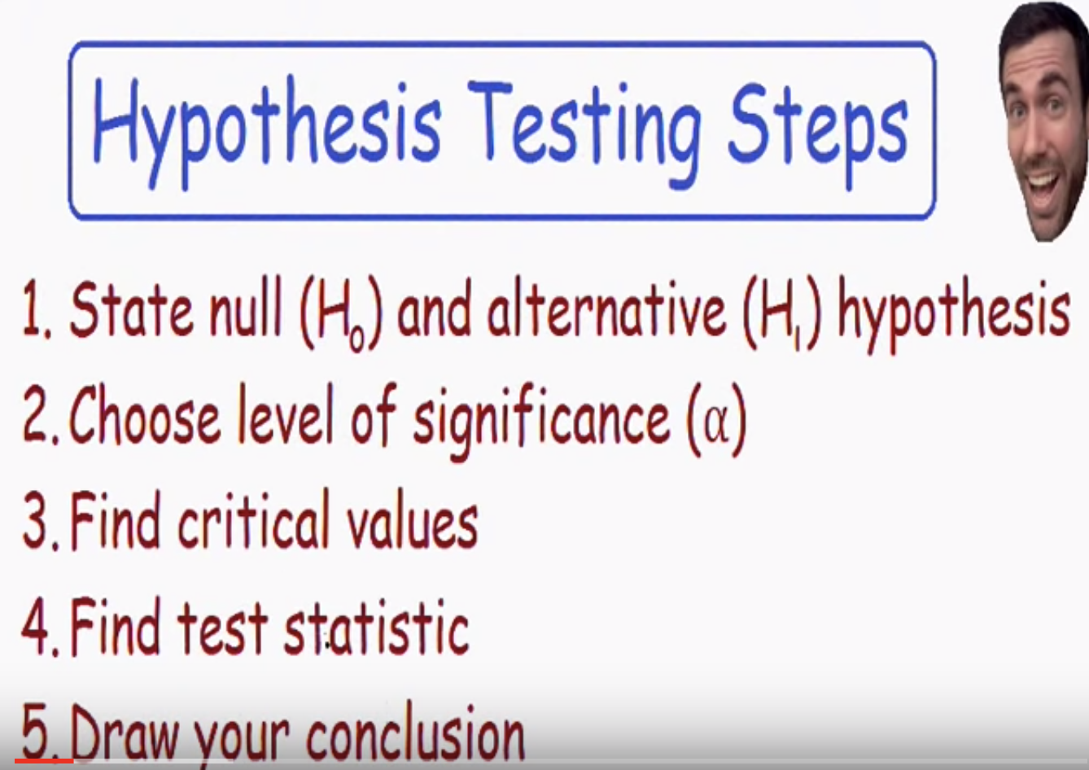
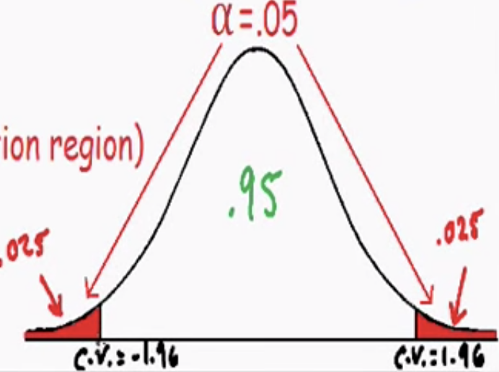
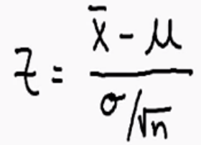
Hypothesis Testing – Statistics https://www.youtube.com/watch?v=0XXT3bIY_pw
2. alpha is usually given, otherwise you have to choose.
Level of significance
= red area in tail = rejection region
It’s a normal curve, we are using
2 tailed test so we have 2 area
= 0.05, each area = 0.025
(0.05 is the most common choice)
Total area under curve = 1
White area=(1-Level of significance)
=0.95 = 95% confidence
interval
95% confidence interval, 0.025 under 1 tail, Z = 1.96
4. Find z value of a given sample
2.89
Sample ave – population(believed) ave
z=
Population standard error = SE
= (105-100)/(15/sqrt(75)) =2.89 in rejection region, its above 1.96
1. H₀=null hypothesis=currently believed to be true (always written with an equal sign)
Average IQ = µ = 100,
H_{a} = alternative hypothesis (always >,<, or !=) = what’s being claimed, It has changed, doesn’t know it’s going up or down
=> µ != 100 => 2 tailed test because !=
3. Critical value can be z or t value, use z value if “population” standard deviation is known.
(=15 here ). Critical value (=z here) is the value that separate the region.
Use a z table to find the z value
5. We can reject the null hypothesis which states that the average µ = 100, and accept that Average µ!= 100
There is enough evidence to suggest the average IQ has changed

Slide 2
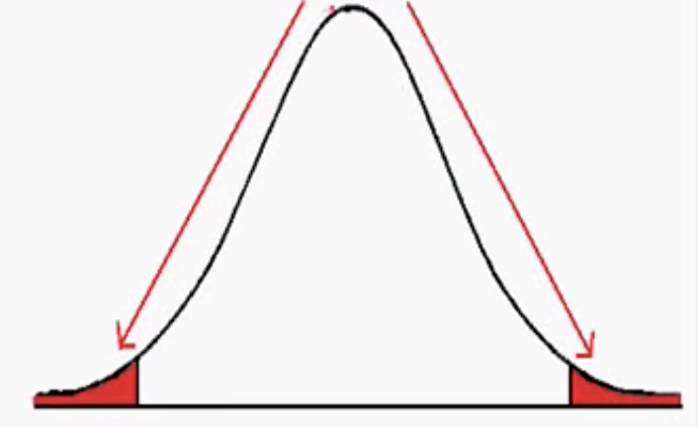
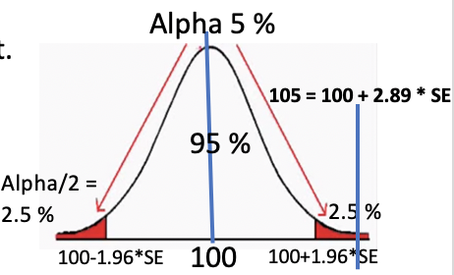
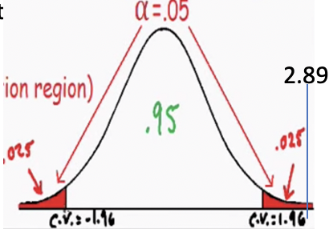
My interpretation:
1 . Hypothesis:
We believe that the average IQ = µ =100, you claim that it’s not, you need to prove it.
Null Hypothesis H_{o} = what we believe : µ = 100
Alternative Hypothesis = H_{a} = what you claim : µ != 100
2. Choose a level of significance
3. Find the critical value
level of significance (=alpha = 1%, 5% most common, 10% )= red area
confidence interval = 1 - level of significance = 99%, 95%, 90%
it says: because we believe µ =100, we select a level of significance = 5% (or confidence interval 95%), and for 95 % confidence level, the range is [100-1.96*SE, 100+1.96*SE], It means with 95% probability, the range will contain the true unknown value of the parameter average IQ (µ) (p66 in book).
4. Find test statistics: you perform a test find the average IQ (=105), which then gives a z value of the sample
we use Z test: z =
Or: 105 = 100 + 2.89 * SE
Draw a conclusion
you do the sampling and find that average IQ = 105 and z = 2.89 => 105 = 100 + 2.89 * SE
and it is not in the previously believed confidence region => previously believed value can be rejected !!!!
Alpha 5 %
105 = 100 + 2.89 * SE
95 %
Alpha/2 =
2.5 %
2.5 %
100-1.96*SE
100
100+1.96*SE
Sample ave – population(believed) ave = 105 - 100
= 2.89 => z = 2.89
standard error = SE = (15/sqrt(75))

Slide 3

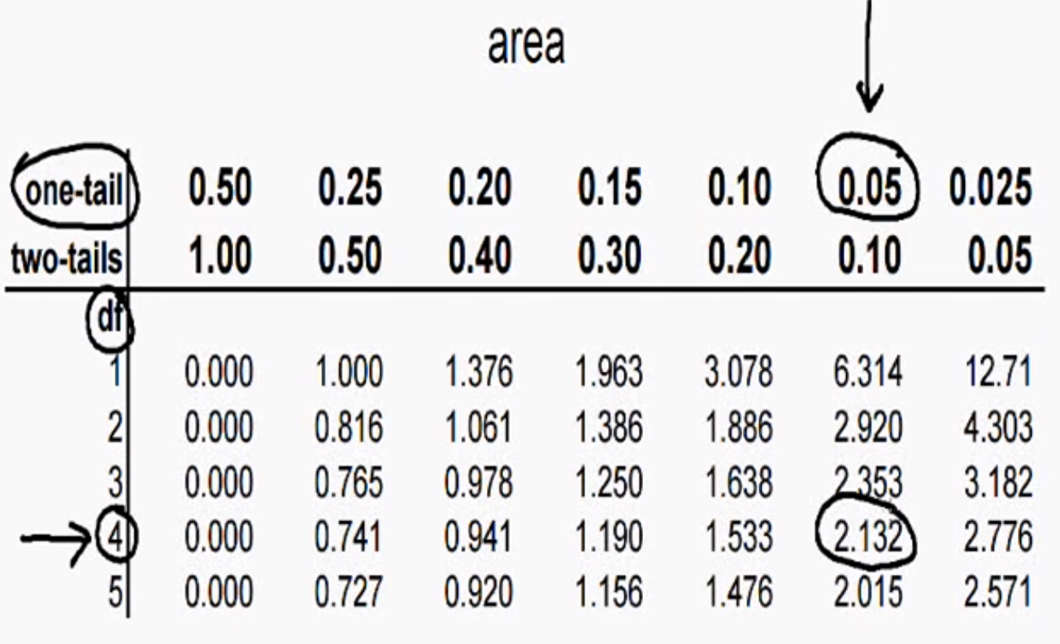
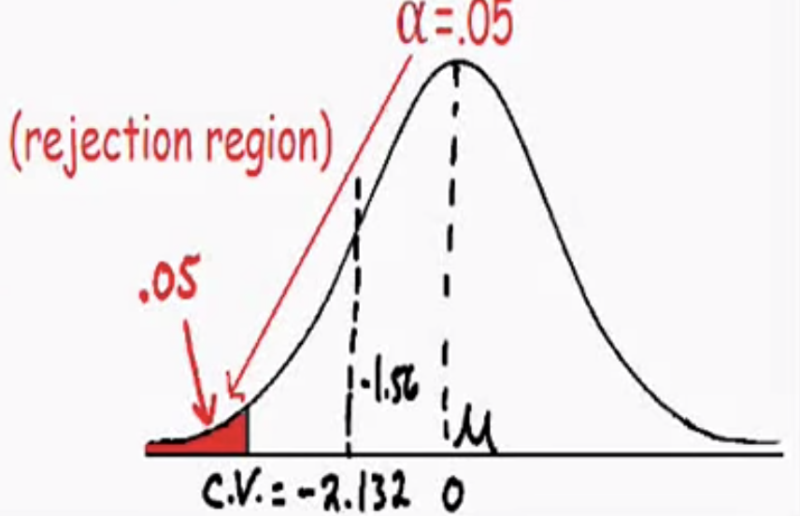
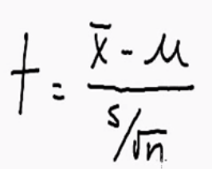
Hypothesis Testing - one tailed 't' distribution https://www.youtube.com/watch?v=lNoxKsuJ6Xc
2. alpha is usually given, otherwise you have to choose.
Level of significance
= red area in tail = rejection region
(0.05 is the most common choice)
Total area under curve = 1
White area=(1-Level of significance)
=0.95
A normal curve
0.05under 1 tail, df=n-1=5-1=4, t = 2.132 (use t= -2.132 because its below average)
-1.56
4. Find t value of a given sample
Sample ave – population(believed) ave
t=
Population standard error = SE
= (89-100)/(15.81/sqrt(5)) =-1.56 (it’s our test statistic) not in red rejection region
Or 89 = 100 – 1.56 * SE
(still in white region)
1. H₀=null hypothesis=currently believed to be true (always written with an equal sign)
Average IQ = µ = 100,
H_{a} = alternative hypothesis (always >,<, or !=) = what’s being claimed, he believes µ < 100
=> 1 tail test (if > or <) with bottom tail because he believes it’s lower than (µ=100)
3. Critical value can be z or t value, use t value if (1)population standard deviation is unknown(true here), or (2)sample size<30(true).
Critical value (=t here) is the value that separate the region.
Use a t table to find the t value
(df=degree of freedom=n-1=5-1=4)
5. We can not reject the null hypothesis (or, we fail to reject the null hypothesis), we accept the null hypothesis that the average µ = 100, and there is not enough evidence to suggest the average IQ is lower.

Slide 4

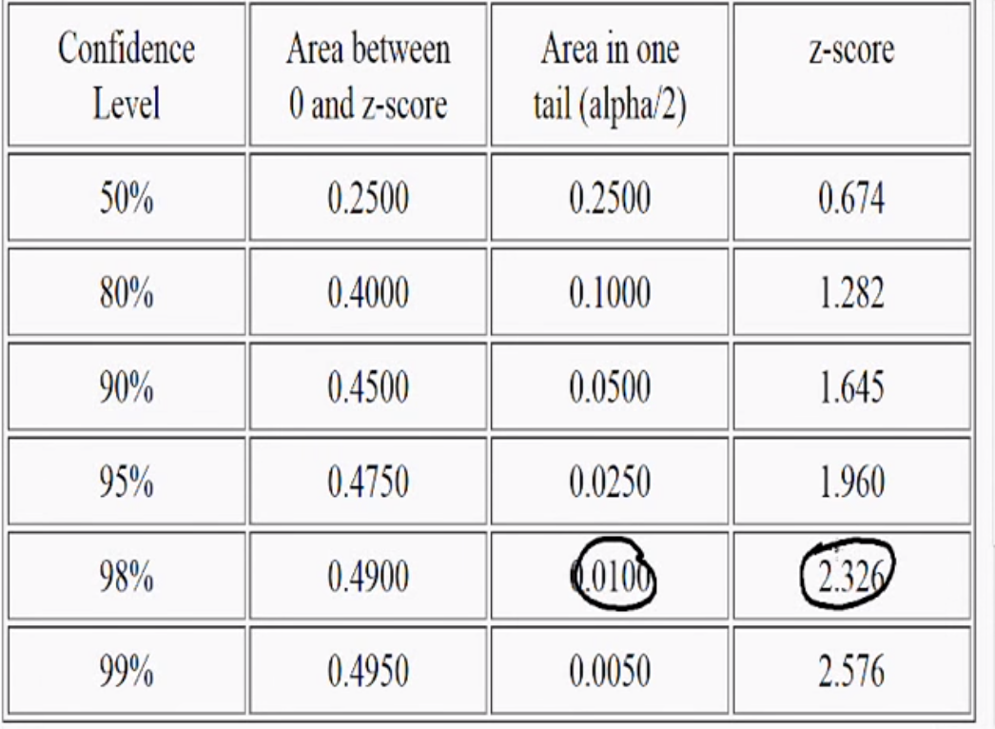
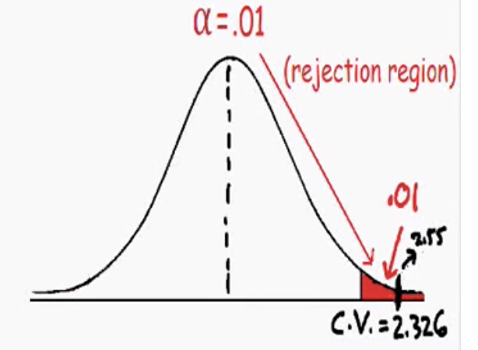
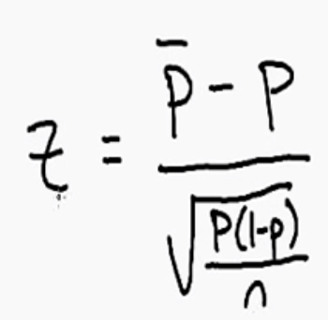
Hypothesis Testing - Proportion Example https://www.youtube.com/watch?v=5LFhu0vGzkI
2. alpha is usually given, otherwise you have to choose.
Level of significance
= red area in tail = rejection region
(choose 0.01 here)
Total area under curve = 1
White area=(1-Level of significance)
=0.99
Use a z table to find the z value
118/200=0.59
A normal curve
0.01under 1 tail, z = 2.326 (use t= +2.326 because its higher than p=0.5)
4. Perform a test, find z of a given sample
Proportion of sample – proportion of population
z=
Sqrt(p(1-p)/n)
= (0.59-0.5)/sqrt(0.5*0.5/200)=2.55 (it’s our test statistic) in red rejection region
3. Critical value can be z or t value, use z value if we have “large sample size”( if PN > 5, (1-P)N > 5 )
P=ave. portion of population=0.5
N=sample size
PN=0.5*200=100 > 5
(1-P)N=(1-0.5)*200=100 > 5
We have large sample size and we can approximate it with normal curve, use z distribution
Critical value(z) separate the region
Or 0.59 = 0.5 + 2.55 * Sqrt(p(1-p)/n)
(in red region)
1. H₀=null hypothesis=currently believed to be true (always written with an equal sign)
Patriot is innocent (p=proportion=0.5)
H_{a} = alternative hypothesis (always >,<, or !=) = what’s being claimed, NFL believes Patriot is guilty (p > 0.5), 1 tail test (if > or <) with upper tail because he believes it’s higher than(p=0.5)
5. We can reject the null hypothesis, and accept the alternative hypothesis that the Patriot is guilty (p > 0.5)

Slide 5


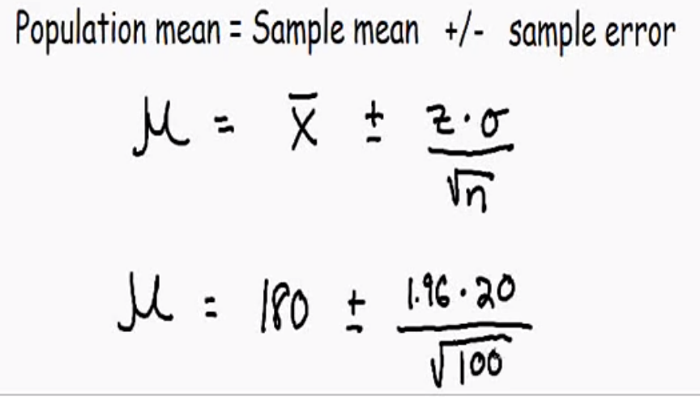
Confidence Intervals – Statistics https://www.youtube.com/watch?v=lwpobQmUTd8
In a perfect word we would measure the weight of ever single mail, then we can get average weight, but its impossible.
With confidence interval, we can select any size (100 here) randomly males and get very good estimation of average weight
its not ok to assume the “population mean” = (“sample mean” = 180 lbs)
its ok to assume that “population mean” = “sample mean” +- sampling error
(Use z table to get z value, for 95% confidence interval, z = 1.96)
(we use z here, sometimes we use t value, it depends on the sample size, or if the population std. deviation is known)
It says : with 95 % of confidence, that the average of the entire population is between 176.08 and 183.92
We take a smaller sample and we can get a very good estimation about the entire population
=> (176.08 ~ 183.92)

Slide 6

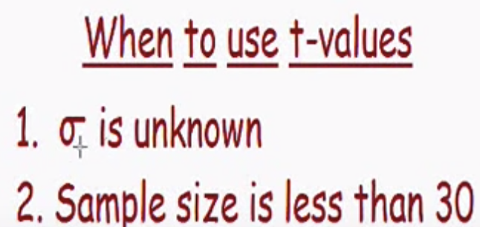
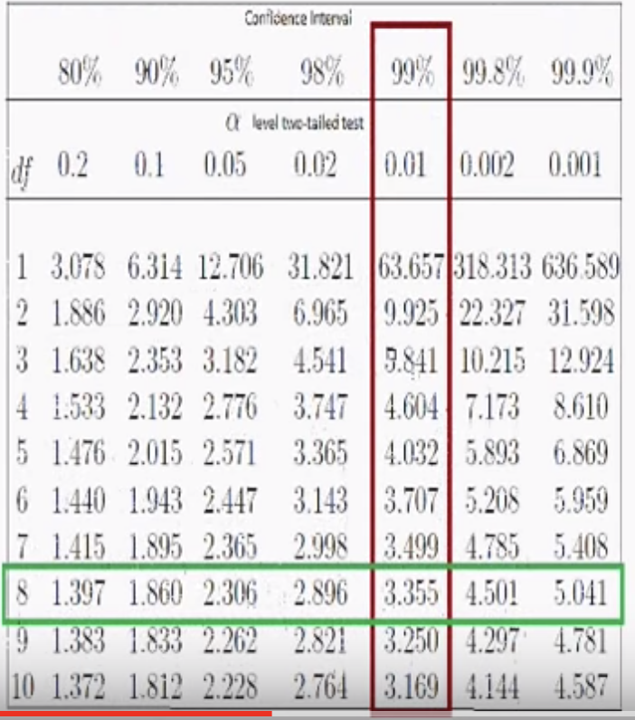
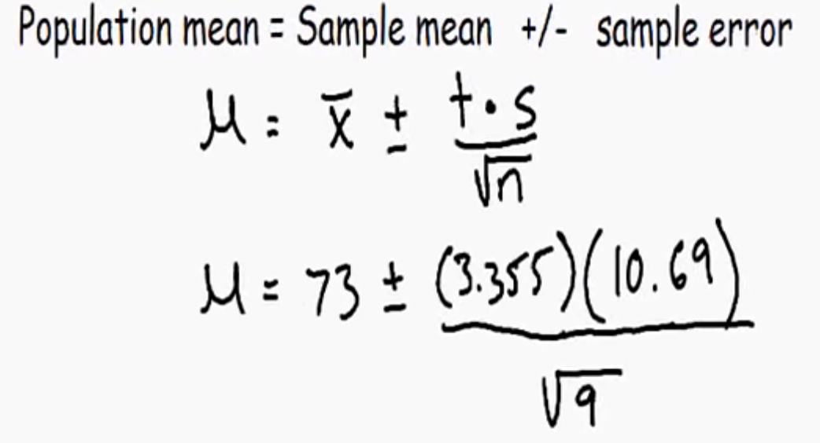
Confidence Intervals - using t distribution https://www.youtube.com/watch?v=UmAJJtEo6cQ
(Population std. deviation is unknown)
Or and ???
Df = degree of freedom = 9-1 = 8
https://math.stackexchange.com/questions/1817980/how-to-know-when-to-use-t-value-or-z-value
=> (176.08 ~ 183.92)

Slide 7





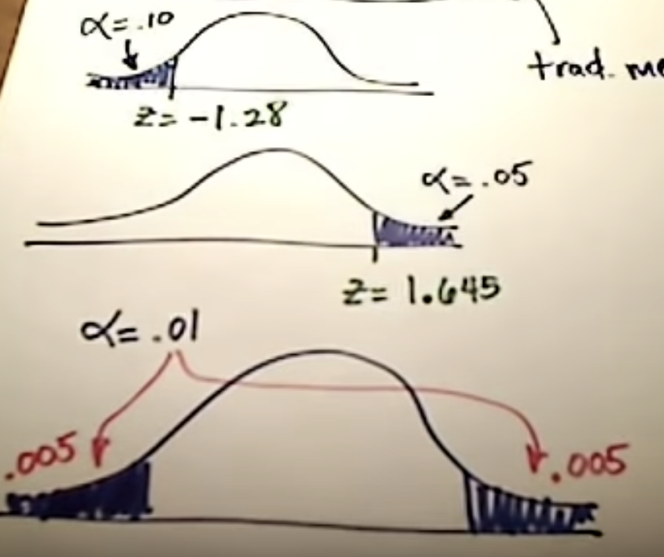
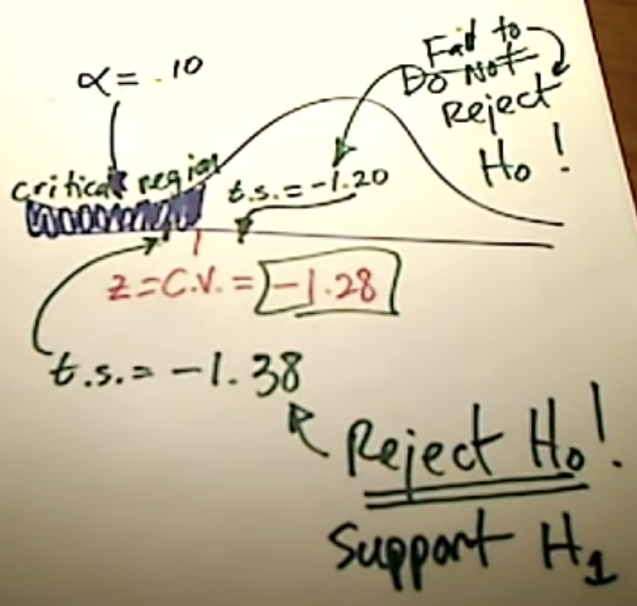
Stats: Hypothesis Testing (Traditional Method) https://www.youtube.com/watch?v=rWFDXt-MlNs
For null hypothesis (H₀): proportions/mean/std deviation always = something
For alternative hypothesis (H₁ or H_{a}): it might has >, < or !=
<: if you see words “less than”, “fewer than”, left-tail test
>: if you see “more than”, “greater than”, right-tail test
!=: two tailed test
Level of significance (alpha) : usually 0.01, 0.05 or 0.1
Transitional and P-value method both rely on test statistic z (or t) value
(given certain data, you can find a test statistic = z or t value)
Transitional method use “critical value” (P method doesn’t use it)
For transitional method, we are interested in “critical values”
Ex: If alpha = 0.1 (alpha=10%), we need to a find a critical z value that corresponds to 10% sitting on the left tail (critical region), we can look it up from a normal distribution table, its z = c.v. = -1.28
Z=-2.575
Z=2.575
If the test statistic in white region (say, -1.2), it’s not smaller than -1.28, then we do not reject the null hypothesis (we fail to reject the null hypothesis)
If the test statistic in blue region (say, -1.38), it’s smaller than -1.28, then we reject the null hypothesis, we accept(support) the alternative hypothesis, we have enough evidence to support our claim

Slide 8
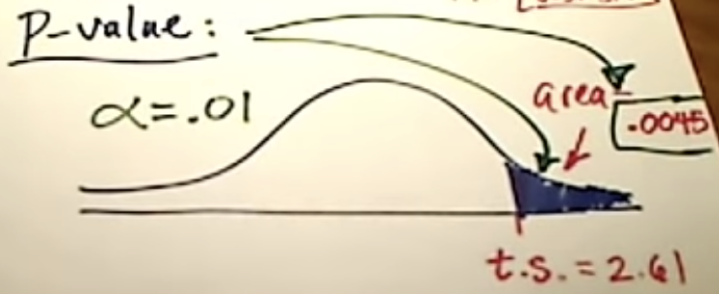

Stats: Hypothesis Testing (P-value Method) https://www.youtube.com/watch?v=cW16A7hXbTo
For null hypothesis (H₀): proportions/mean/std deviation always = something
For alternative hypothesis (H₁ or H_{a}): it might has >, < or !=
<: if you see words “less than”, “fewer than”, left-tail test
>: if you see “more than”, “greater than”, right-tail test
!=: two tailed test
Level of significance (alpha) : usually 0.01, 0.05 or 0.1
Transitional and P-value method both rely on test statistic z (or t) value
(given certain data, you can find a test statistic = z or t value)
Transitional method use “critical value” (P method doesn’t use it)
Ex: we are dealing with right-tail test, and we can find the test statistic (t.s.) of the samples,
say t.s. = 2.61, the area sitting on the right of this t.s. value = 0.0045, this area is p-value !!
We are going to compare p-value with significance level (say, alpha = 0.01)
If p–value < alpha: if p-value is low, the null must go (reject null hypothesis, support the claim, support the alternative hypothesis)
If p–value > alpha: if p-value is high, the null must fly (keep null hypothesis, fail to reject null)
Alpha = 0.01 = 1% level of significance
P-value = 0.0045
t.s. = 2.61
P-value < alpha : t.s. in reject region
>. Not in

